Slide 1
Creating an image resize function
Section 5
Notes:
[Mandatory Slide] This would be the introduction slide of the topic that you are covering in this section.
When this slide plays, you could talk about the main aim that we’d be covering in this section.

Slide 2
In this Section, we are going to take a look at…
Creating and deploying an image resize function
Creating an S3 bucket for storing images
Configuring redirect rules
Creating a serverless service
Deploying the service through Docker
Notes:
Mandatory Slide]
This talks about the main steps that are taken to reach the aim of the section. This is basically the highlight of each video that is a part of this section in a list form so that the viewers know what they are getting into.
[

Slide 3
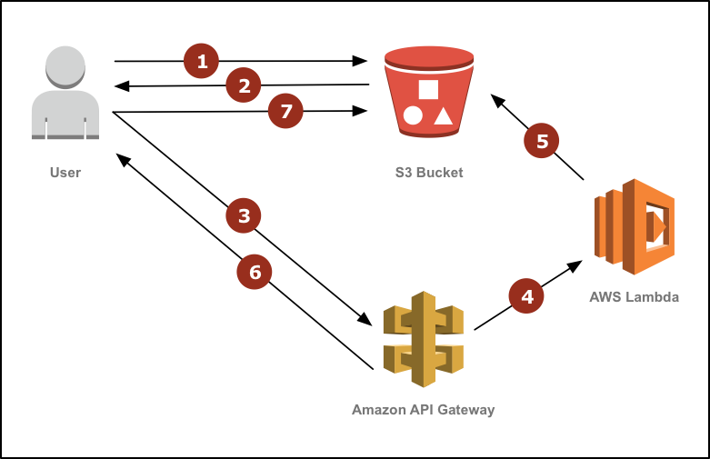
Image credit: https://aws.amazon.com/blogs/compute/resize-images-on-the-fly-with-amazon-s3-aws-lambda-and-amazon-api-gateway/

Slide 4
Creating an S3 bucket for storing images
Video 5.1
Notes:
[Mandatory Slide] This would be the introduction slide of the topic that you are covering in this subsection.
When this slide plays, you could talk about the main aim that we’d be covering in this video.

Slide 5
In this Video, we are going to take a look at…
Creating an S3 bucket
Configure bucket permissions
Enable bucket static web hosting
Upload sample images to resize
Notes:
[Mandatory Slide]
Before the start of the video, we’d like to highlight what are important topics or pointers that we’d be covering in this video. This slide would immediately follow the intro/name slide. This would just be say 2-3 points for the viewers to know what they are getting into.

Slide 6
Creating the image resize service
Next Video
Notes:
[Mandatory Slide]
Here the name of the next video needs to be mentioned. The narration as you guessed it would be just letting the viewer know exactly where we are at and what we’d be taking over next! ☺

